Slide 1



HACKATHON ON NOVEL APPLICATIONS FOR IOT USING ML

Slide 2

CONTENT
01
OUR TEAM
02
PROBLEM STATEMENT
03
WHAT IS ANOMALY
04
THE DATASET
05
IMPLEMENTATION
06
LSTM NETWORK
07
REFERENCES

Slide 3





OUR TEAM
Ankur Chanda
Subhadeep
Chakraborty
Soumili
Chakraborty
Diptendu Majumdar
12021002016076
12021002020028
12021002016065
12021002016067
Dept. of CSE(AIML) 3rd Year

Slide 4



PROBLEM STATEMENT
Mission
Automated Anomaly Detection in Industrial IoT:
Creating anomaly detection systems
to identify irregularities in industrial IoT data, potentially preventing equipment failures.
Vision
Preventing Equipment Failures: The ultimate goal is to preemptively detect and address irregularities in data, preventing costly equipment failures and associated downtime.
Anomaly Detection Systems: Emphasizes the primary objective of the project, which is to create sophisticated, systems capable of identifying anomalies in industrial IoT data.

Slide 5
WHAT IS ANOMALY
In machine learning and data mining, anomaly detection is the task of identifying the rare items, events or observations which are suspicious and seem different from the majority of the data. These anomalies can indicate some kind of problems such as fraudulent transactions, medical problems, failure of industrial equipment, etc.

Slide 6

THE DATASET
In this project, we have used the Numenta Anomaly Benchmark (NAB) data set. It is a novel benchmark for evaluating ML algorithms in anomaly detection in streaming, online applications.
This dataset also comprises a time-series data named ‘ambient_temperature_system_failure’ in the CSV format. It comprises temperature sensor data of an office setting. This is data for which we know the anomaly causes; no hand labeling.
INTRODUCTION
DESCRIPTION

Slide 7

IMPLEMENTATION
1
2
3
4
5
DATASET
VISUALISATION
PREPROCESSING
MODEL BUILDING
MODEL PREDICTION
Real office data from IoT sensors is collected and stored in a CSV file, which serves as the basis for model development and predictions.
To check whether the data is read successfully, we see the header of the file and then visualize the data through plotting.
To check the stability of temperature during days and nights of weekdays and weekends we preprocess our data accordingly. and scale our data.
We define and add layers to the LSTM Recurrent Neural Network. Once, the model is defined and compiled successfully, we train our model and tune the hyperparameters.
The most distant predicted values are considered as anomalies. Finally we plot the predictions and visualise the anomalies.

Slide 8

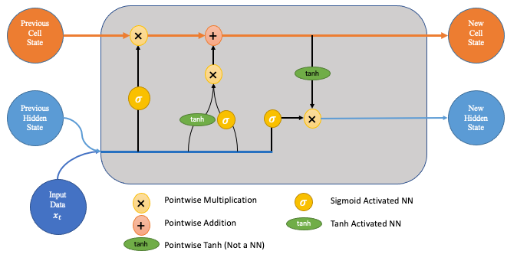

LSTM NETWORK
We know that RNNs are capable of remembering the characteristics of previous inputs and outputs. But for how long can it remember. For certain cases, the immediate previous output may not just be enough to predict what’s coming and the network may have to rely on information from a further previous output.
Long Short Term Memory or LSTM networks are a special kind of RNNs that deals with the long term dependency problem effectively. LSTM networks have a repeating module that has 4 different neural network layers interacting to deal with the long term dependency problem.

Slide 9
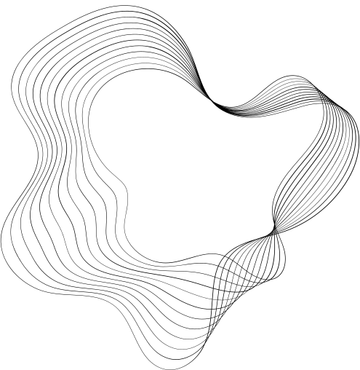
REFERENCES
A Zimek, E Schubert, “Outlier Detection”, Encyclopedia of Database Systems, Springer New York.
V. J. Hodge, J Austin, “A Survey of Outlier Detection Methodologies”, Artificial Intelligence Review.
BoltzmannBrain, “Numenta Anomaly Benchmark: Dataset and scoring for detecting anomalies in streaming data”, Kaggle.
Victor Ambonati, “Unsupervised Anomaly Detection”, Kaggle.

Slide 10

THANKS

